Slide 1
Applying temperature readout adjustment

Slide 2
Problem Statement
Measured temperature by the MATHIS cook surface and air temperature sensors do not match those of the thermocouples during testing. They require adjustment to give accurate readings to customers.

Slide 3
How Ooni handles this within our ovens

Slide 4
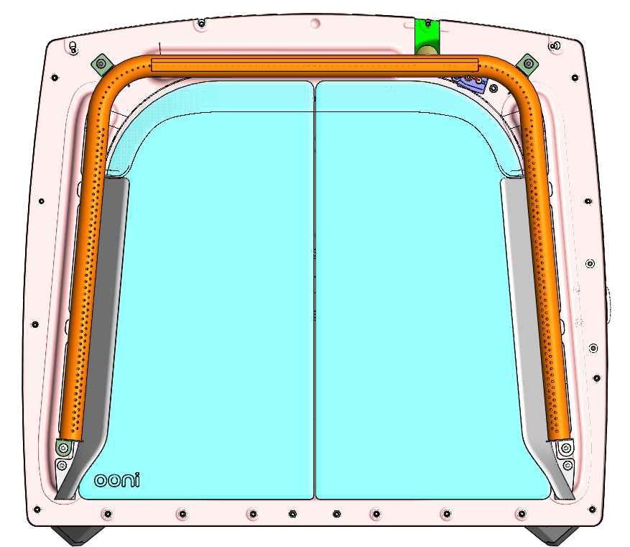
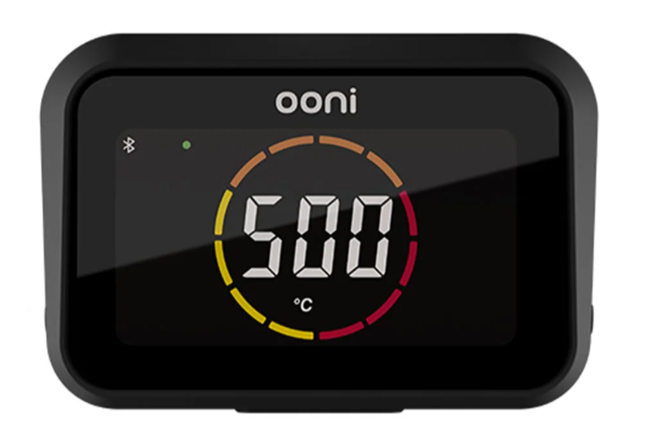
DTH Logic Overview
x
y
y=Ax^4+Bx^3+Cx^2+Dx+E
The ‘raw’ temperature from the thermocouple is transformed by a coefficient (a polynomial equation) so that it is more representative of cooking temperatures
The transformed temperature reading is displayed on the DTH
A thermocouple (temperature sensor) reads the temperature at it’s location in the oven
Each oven has it’s own coefficient which is controlled by selecting an oven profile

Slide 5
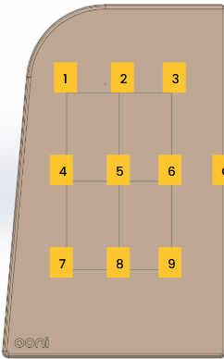
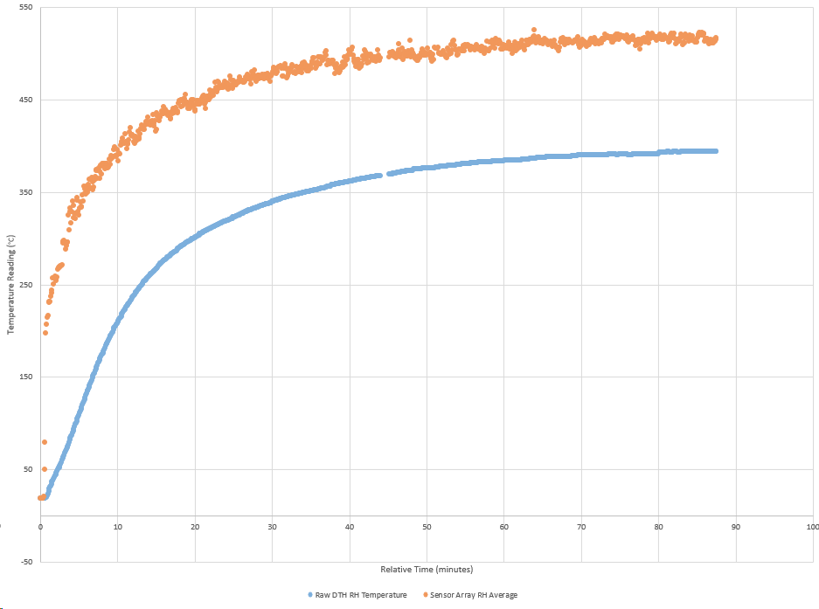
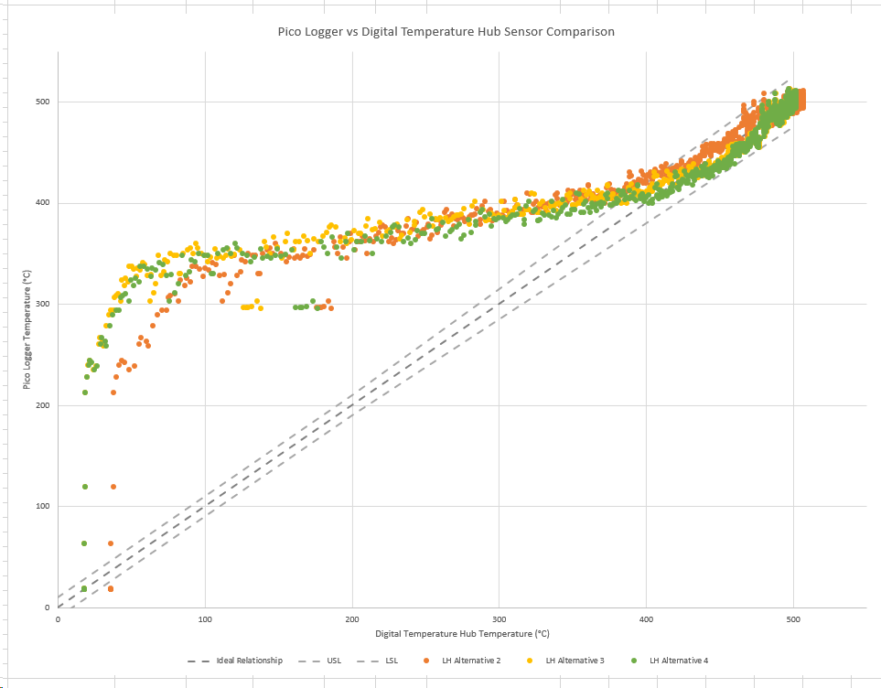
How a coefficient is made
A test thermocouple array is placed on the stone
DTH measures raw temperature from oven thermocouple
Both temperature curves are mapped and compared
A coefficient is created to modify the raw oven thermocouple readouts to better represent the temperature in the centre of the oven

Slide 6
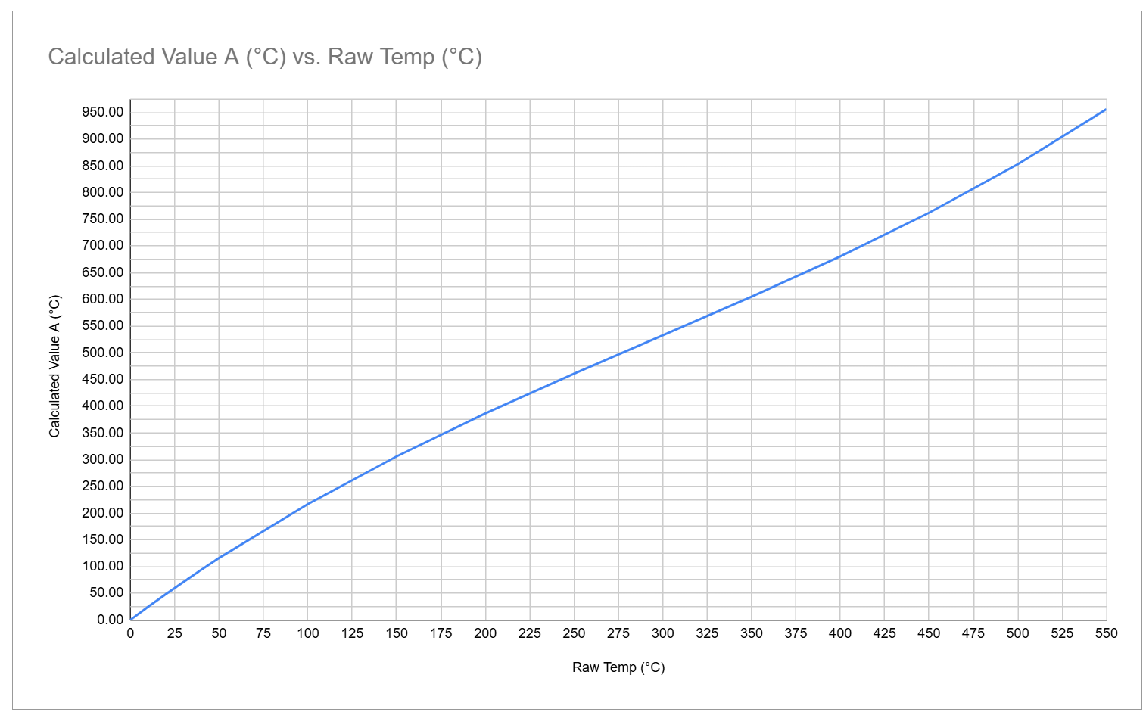
Koda 2 Pro Coefficient
In the case of the Koda 2 Pro the coefficient operates as follows:
Max reading the DTH can display is 537°C (999°F)
To reach DTH max reading the thermocouple would need to reach 302°C
It is not an exact multiplication of numbers, it is a line equation

